Slide 1
Software Engineering
Credits: 3:0:0:0
Faculty: Dr. Naresh E

Slide 2
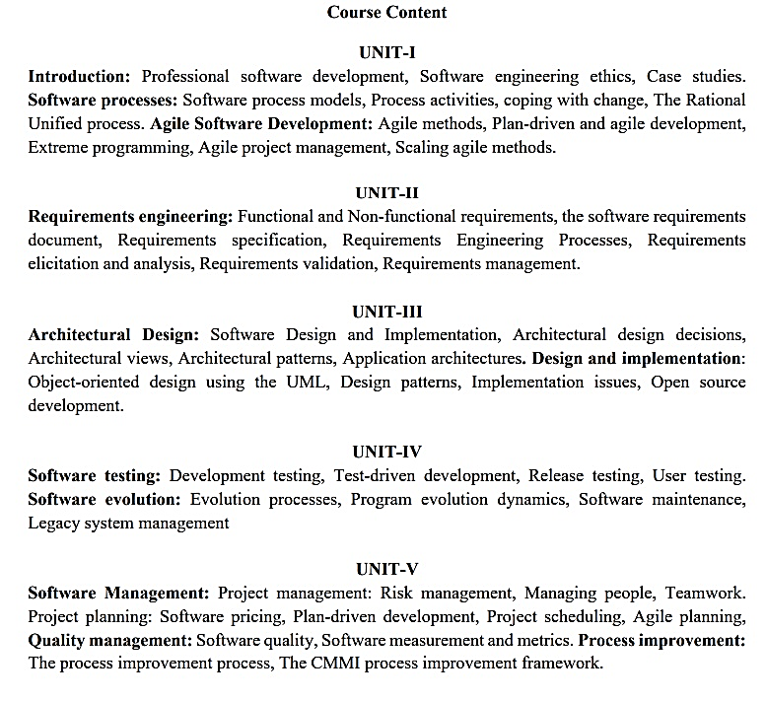

Slide 3
Text Books
Ian Sommerville, Software Engineering, 9th Edition, Pearson Education, 2011.
Apple Book, Develop in Swift Explorations, Apple, 2020.
References
Roger S. Pressman, Software Engineering-A Practitioners approach, 8th Edition, McGraw-Hill, 2014.
Shari Lawrence Pfleeger, Joanne M. Atlee, Software Engineering Theory and Practice, Third Edition, Pearson Education, 2006.
Waman S Jawadekar, Software Engineering Principles and Practice, Tata McGraw Hill, 2004.
Douglas Bell, Software Engineering for Students, a Programming Approach, 4th Edition, Pearson Education.

Slide 4
CIE Marks Distribution
30 Marks - IA test ( Average of two tests)
10 Marks - Assignment
10 Marks - Case Study

Slide 5
Introduction
- Engineering

Slide 6
software
Computer programs and associated documentation such as requirements, design models and user manuals.
Software products may be developed for a particular customer or may be developed for a general market.
Software products may be
Generic - developed to be sold to a range of different customers e.g. PC software such as Excel or Word.
Bespoke (custom) - developed for a single customer according to their specification.
New software can be created by developing new programs, configuring generic software systems or reusing existing software.

Slide 7
software engineering
Software engineering is an engineering discipline that is concerned with all aspects of software production.
Software engineers should adopt a systematic and organised approach to their work and use appropriate tools and techniques depending on the problem to be solved, the development constraints and the resources available.

Slide 8
Difference between software engineering and computer science
Computer science is concerned with theory and fundamentals; software engineering is concerned with the practicalities of developing and delivering useful software.
Computer science theories are still insufficient to act as a complete underpinning for software engineering (unlike e.g. physics and electrical engineering).

Slide 9
Difference between software engineering and system engineering
System engineering is concerned with all aspects of computer-based systems development including hardware, software and process engineering. Software engineering is part of this process concerned with developing the software infrastructure, control, applications and databases in the system.
System engineers are involved in system specification, architectural design, integration and deployment.

Slide 10
Software process
A set of activities whose goal is the development or evolution of software.
Generic activities in all software processes are:
Specification - what the system should do and its development constraints
Development - production of the software system
Validation - checking that the software is what the customer wants
Evolution - changing the software in response to changing demands.

Slide 11
Software process model
A simplified representation of a software process, presented from a specific perspective.
Examples of process perspectives are
Workflow perspective - sequence of activities;
Data-flow perspective - information flow;
Role/action perspective - who does what.
Generic process models
Waterfall;
Iterative development;
Component-based software engineering.

Slide 12
Attributes of good software
The software should deliver the required functionality and performance to the user and should be maintainable, dependable and acceptable.
Maintainability
Software must evolve to meet changing needs;
Dependability
Software must be trustworthy;
Efficiency
Software should not make wasteful use of system resources;
Acceptability
Software must accepted by the users for which it was designed. This means it must be understandable, usable and compatible with other systems.

Slide 13
Key challenges facing software engineering
Heterogeneity, delivery and trust.
Heterogeneity
Developing techniques for building software that can cope with heterogeneous platforms and execution environments;
Delivery
Developing techniques that lead to faster delivery of software;
Trust
Developing techniques that demonstrate that software can be trusted by its users.

Slide 14
Professional and ethical responsibility
Software engineering involves wider responsibilities than simply the application of technical skills.
Software engineers must behave in an honest and ethically responsible way if they are to be respected as professionals.
Ethical behaviour is more than simply upholding the law.

Slide 15
Issues of professional responsibility
Confidentiality
Engineers should normally respect the confidentiality of their employers or clients irrespective of whether or not a formal confidentiality agreement has been signed.
Competence
Engineers should not misrepresent their level of competence. They should not knowingly accept work which is outwith their competence.

Slide 16
Issues of professional responsibility
Intellectual property rights
Engineers should be aware of local laws governing the use of intellectual property such as patents, copyright, etc. They should be careful to ensure that the intellectual property of employers and clients is protected.
Computer misuse
Software engineers should not use their technical skills to misuse other people’s computers. Computer misuse ranges from relatively trivial (game playing on an employer’s machine, say) to extremely serious (dissemination of viruses).

Slide 17
The software process
A structured set of activities required to develop a software system
Specification;
Design;
Validation;
Evolution.
A software process model is an abstract representation of a process. It presents a description of a process from some particular perspective.

Slide 18
Generic software process models
The waterfall model
Separate and distinct phases of specification and development.
Evolutionary development
Specification, development and validation are interleaved.
Component-based software engineering
The system is assembled from existing components.
There are many variants of these models e.g. formal development where a waterfall-like process is used but the specification is a formal specification that is refined through several stages to an implementable design.

Slide 19
Waterfall model

Slide 20
Waterfall model
Advantages
Simple and easy to use.
Phases are processed and completed one at a time.
Works well for smaller projects where requirements are very well understood.
As it is a sequential approach, it is easy to plan and follow up progress.
Disadvantages
Customers find it hard to state all requirements initially.
The first build of software takes a long time.
Incorporating changes is harder, as this is difficult to backtrack.
Poor model for complex and object-oriented projects.
Poor model for long and on-going projects.

Slide 21
Evolutionary development
Exploratory development
Objective is to work with customers and to evolve a final system from an initial outline specification. Should start with well-understood requirements and add new features as proposed by the customer.
Throw-away prototyping
Objective is to understand the system requirements. Should start with poorly understood requirements to clarify what is really needed.

Slide 22
Evolutionary development

Slide 23
Evolutionary development
Advantages (Applicability)
For small or medium-size interactive systems;
For parts of large systems (e.g. the user interface);
For short-lifetime systems.
Disadvantages (Problems)
Lack of process visibility;
Systems are often poorly structured;
Special skills (e.g. in languages for rapid prototyping) may be required.

Slide 24
Component-based software engineering
Based on systematic reuse where systems are integrated from existing components or COTS (Commercial-off-the-shelf) systems.
Process stages
Component analysis;
Requirements modification;
System design with reuse;
Development and integration.
This approach is becoming increasingly used as component standards have emerged.

Slide 25
Reuse-oriented development

Slide 26
Process iteration
System requirements ALWAYS evolve in the course of a project so process iteration where earlier stages are reworked is always part of the process for large systems.
Iteration can be applied to any of the generic process models.
Two (related) approaches
Incremental delivery;
Spiral development.

Slide 27
Incremental delivery
Rather than deliver the system as a single delivery, the development and delivery is broken down into increments with each increment delivering part of the required functionality.
User requirements are prioritised and the highest priority requirements are included in early increments.
Once the development of an increment is started, the requirements are frozen though requirements for later increments can continue to evolve.

Slide 28
Incremental development (Proposed by D. L. Parnas in the year 1980)

Slide 29
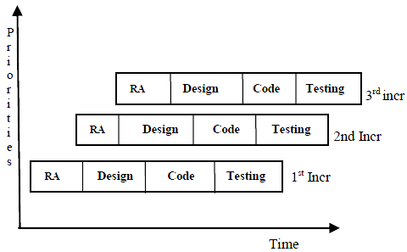
Low
High

Slide 30
The incremental model
Advantages
Generates working software quickly and early during the software life cycle.
More flexible – less costly to change scope and requirements.
Easier to test and debug during a smaller iteration.
Easier to manage risk because risky pieces are identified and handled during its iteration.
Each iteration is an easily managed milestone.
Disadvantages
Each phase of an iteration is rigid and do not overlap each other.
Problems may arise pertaining to system architecture because not all requirements are gathered up front for the entire software life cycle.

Slide 31
Spiral Model (Barry Boehm, 1988)
The spiral model is similar to the incremental model, with more emphases placed on risk analysis.
A software project repeatedly passes through these phases in iterations (called Spirals in this model). The baseline spiral, starting in the planning phase, requirements are gathered and risk is assessed. Each subsequent spirals builds on the baseline spiral.

Slide 32
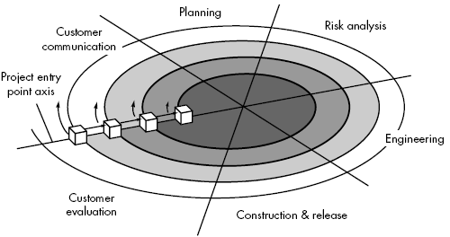
Spiral model

Slide 33
Boehm’s Spiral model

Slide 34
Spiral model sectors
Objective setting
Specific objectives for the phase are identified.
Risk assessment and reduction
Risks are assessed and activities put in place to reduce the key risks.
Development and validation
A development model for the system is chosen which can be any of the generic models.
Planning
The project is reviewed and the next phase of the spiral is planned.

Slide 35
Spiral Model
Advantages
High amount of risk analysis
Good for large projects.
Mainly for OO software development.
Software is produced early in the software life cycle.
Disadvantages
Can be a costly model to use.
Risk analysis requires highly specific expertise.
Project’s success is highly dependent on the risk analysis phase.
Doesn’t work well for smaller projects

Slide 36
The Rational Unified Process
A modern process model derived from the work on the UML and associated process.
Normally described from 3 perspectives
A dynamic perspective that shows phases over time;
A static perspective that shows process activities;
A practive perspective that suggests good practice.

Slide 37
RUP phases
Inception
Establish the business case for the system.
Elaboration
Develop an understanding of the problem domain and the system architecture.
Construction
System design, programming and testing.
Transition
Deploy the system in its operating environment.

Slide 38
The Unified Process (UP)
elaboration
inception

Slide 39
RUP phase model

Slide 40
RUP good practice
Develop software iteratively
Manage requirements
Use component-based architectures
Visually model software
Verify software quality
Control changes to software

Slide 41
Computer-aided software engineering
Computer-aided software engineering (CASE) is software to support software development and evolution processes.
Activity automation
Graphical editors for system model development;
Data dictionary to manage design entities;
Graphical UI builder for user interface construction;
Debuggers to support program fault finding;
Automated translators to generate new versions of a program.

Slide 42
What is CASE (Computer-Aided Software Engineering)
Software systems that are intended to provide automated support for software process activities.
CASE systems are often used for method support.
Upper-CASE
Tools to support the early process activities of requirements and design;
Lower-CASE
Tools to support later activities such as programming, debugging and testing.

Slide 43
CASE classification
Classification helps us understand the different types of CASE tools and their support for process activities.
Functional perspective
Tools are classified according to their specific function.
Process perspective
Tools are classified according to process activities that are supported.
Integration perspective
Tools are classified according to their organisation into integrated units.

Slide 44
Functional tool classification

Slide 45
Activity-based tool classification

Slide 46
CASE integration
Tools
Support individual process tasks such as design consistency checking, text editing, etc.
Workbenches
Support a process phase such as specification or design, Normally include a number of integrated tools.
Environments
Support all or a substantial part of an entire software process. Normally include several integrated workbenches.

Slide 47
Tools, workbenches, environments

Slide 48
What are the costs of software engineering?
Roughly 60% of costs are development costs, 40% are testing costs. For custom software, evolution costs often exceed development costs.
Costs vary depending on the type of system being developed and the requirements of system attributes such as performance and system reliability.
Distribution of costs depends on the development model that is used.

Slide 49
Activity cost distribution

Slide 50
Product development costs

Slide 51
Agile Software Development
Naresh.E, RIT, Bangalore-54.
51
Notes:
Naresh.E, Lecturer, Dept. of ISE, MSRIT, Bangalore-54.
51

Slide 52
Agile software development is an iterative and incremental (evolutionary) approach to software development
which is performed in a highly collaborative manner
with "just enough" ceremony
that produces high quality software
which meets the changing needs of its stakeholders
Agile software development is a conceptual framework for software engineering that promotes development iterations throughout the life-cycle of the project.
52

Slide 53
Principles of Agile Methods:
Customer satisfaction by rapid, continuous delivery of useful software.
Working software is delivered frequently (weeks rather than months).
Working software is the principal measure of progress.
Even late changes in requirements are welcomed.
Close, daily cooperation between business people and developers.
Face-to-face conversation is the best form of communication.
Continuous attention to technical excellence and good design.
Simplicity.
Self-organizing teams.
Regular adaptation to changing circumstances.
53

Slide 54
Agile Methods
Some of the few agile software development methods are:
Extreme Programming
Scrum
Adaptive Software Development (ASD)‏
Dynamic Systems Development Method (DSDM)‏
Feature Driven Development
Lean Software Development
Agile Unified Process (AUP)‏
54

Slide 55
Agile Methods: eXtreme Programming (XP)‏
What is Extreme Programming?
It is a deliberate and disciplined approach to software development.
XP is successful because it stresses customer satisfaction.
Why this methodology is designed?
The methodology is designed to deliver the software for the customer
needs when it is needed.
XP empowers your developers to confidently respond to changing customer
requirements, even late in the life cycle.
This methodology also emphasizes team work.
Managers, customers, and developers are all part of a team dedicated to delivering quality software.
55

Slide 56
XP is different.
It is a lot…, like a jig saw puzzle. There are many small pieces. Individually the pieces make no sense, but when combined together a complete picture can be seen. This is a significant departure from traditional software development methods.
56

Slide 57
XP Practices
The Planning Game – Quickly determine the scope of the next release by combining business priorities and technical estimates.
As reality overtakes the plan, update the plan.
Small releases – Put a simple system into production quickly,
then release new versions on a very short cycle.
Simple design – The system should be designed as simply as possible at any given moment. Extra complexity is removed.
The requirements will change tomorrow, so only do what's needed to meet today's requirements.
Refactoring – Programmers restructure the system without
changing its behavior to remove duplication, improve communication, simplify, or add flexibility.
Pair programming – All production code is written with two people at one machine.
57

Slide 58
Contd…
Collective ownership – Anyone can change code anywhere in the system at any time.
Continuous integration – Integrate and build the system many times a day, every time a task is completed.
40-hour week – Work no more than 40 hours a week as a rule.
Never work overtime a second week in a row.
On-site customer – Include a real, live user on the team,
available full-time to answer questions.
58

Slide 59
The XP release cycle
Select user
Break down
stories for this
stories to tasks
Plan release
release
Evaluate
Release
Develop/integ
rate/
system
software
test software
59

Slide 60
Story card for document downloading
60

Slide 61
Task cards for document downloading
61
Notes:
Naresh.E, Lecturer, Dept. of ISE, MSRIT, Bangalore-54.
61

Slide 62
Testing in XP
Key features of testing in XP:
Test-first development.
Incremental test development from scenarios.
User involvement in test development and validation.
Automated test harnesses are used to run all component tests each time that a new release is built.
62

Slide 63
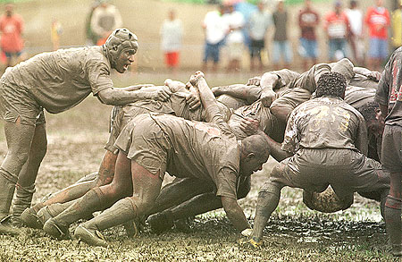
Scrum
63
Notes:
Naresh.E, Lecturer, Dept. of ISE, MSRIT, Bangalore-54.
63
Rugby ball, Here it is treated as a small software piece, which is to be delivered to the customer within the limited time period. So the scrum team has an enthusiasm that they will fight to share in developing the software piece.

Slide 64
Scrum in 100 words
Scrum is an agile process that allows us to focus on delivering the highest business value in the shortest time.
It allows us to rapidly and repeatedly inspect actual working software (every two weeks to one month).
The business sets the priorities. Our teams self-manage to determine the best way to deliver the highest priority features.
Every two weeks to a month anyone can see real working software and decide to release it as is or continue to enhance for another iteration.
64

Slide 65
History of Scrum
1995:
analysis of common software development processes → not suitable for empirical, unpredictable and non-repeatable processes
Design of a new method: Scrum by Jeff Sutherland & Ken Schwaber
Enhancement of Scrum by Mike Beedle & combination of Scrum with Extreme Programming
1996:
introduction of Scrum at OOPSLA conference
2001:
publication “Agile Software Development with Scrum” by Ken Schwaber & Mike Beedle
Successful appliance of Scrum in over 50 companies
Founders are members in the Agile Alliance
65

Slide 66
Characteristics
Self-organizing teams
Product progresses in a series of month-long “sprints”
Requirements are captured as items in a list of “product backlog”
No specific engineering practices prescribed
Uses generative rules to create an agile environment for delivering projects
One of the “agile processes”
66

Slide 67
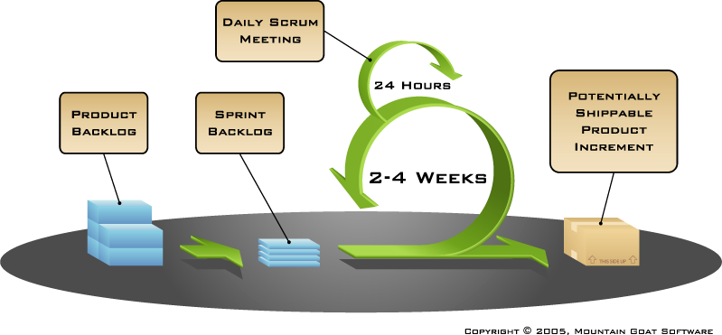
How Scrum Works?
67

Slide 68
Scrum Framework
Roles : Product Owner, Scrum Master, Team
Ceremonies : Sprint Planning, Sprint Review, Sprint Retrospective, & Daily Scrum Meeting
Artifacts : Product Backlog, Sprint Backlog, and Burndown Chart
68

Slide 69
Product Owner
Define the features of the product
Decide on release date and content
Be responsible for the profitability of the product (ROI)‏
Prioritize features according to market value
Adjust features and priority every iteration, as needed
Accept or reject work results.
69

Slide 70
The Scrum Master
Represents management to the project
Responsible for enacting Scrum values and practices
Removes impediments
Ensure that the team is fully functional and productive
Enable close cooperation across all roles and functions
Shield the team from external interferences
70

Slide 71
Scrum Team
Typically 5-10 people
Cross-functional
QA, Programmers, UI Designers, etc.
Members should be full-time
May be exceptions (e.g., System Admin, etc.)‏
Teams are self-organizing
What to do if a team self-organizes someone off the team??
Ideally, no titles but rarely a possibility
Membership can change only between sprints
71

Slide 72
Daily Scrum
Parameters
Daily
15-minutes
Stand-up
Not for problem solving
Three questions:
What did you do yesterday
What will you do today?
What obstacles are in your way?
Chickens and pigs are invited
Help avoid other unnecessary meetings
Only pigs can talk
72
Notes:
Naresh.E, Lecturer, Dept. of ISE, MSRIT, Bangalore-54.
72
Chickens are product owner, manager, clients, etc.
Pigs are scrum team members.

Slide 73
Product Backlog
A list of all desired work on the project
Usually a combination of
story-based work (“let user search and replace”)‏
task-based work (“improve exception handling”)‏
List is prioritized by the Product Owner
Typically a Product Manager, Marketing, Internal Customer, etc.
73

Slide 74
Product Backlog...
Requirements for a system, expressed as a prioritized list of Backlog Items
Is managed and owned by a Product Owner
Spreadsheet (typically)‏
Usually is created during the Sprint Planning Meeting
Can be changed and re-prioritized before each PM
74

Slide 75
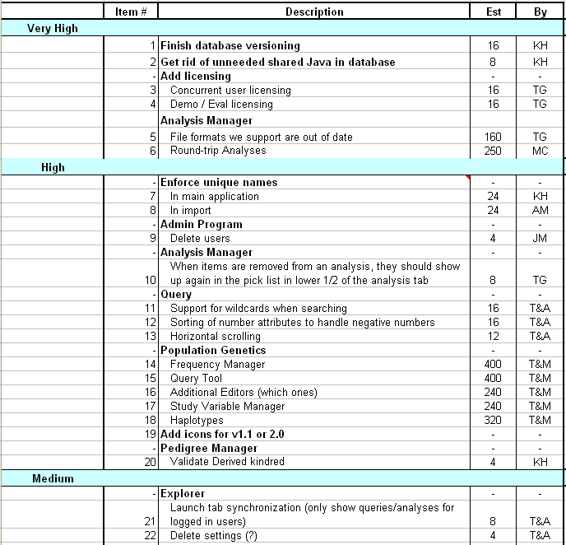
Sample Product Backlog
75
Notes:
Naresh.E, Lecturer, Dept. of ISE, MSRIT, Bangalore-54.
75
Very High, High, and Medium: represents the priority of the requirements.
Item#: represents the priority numbers (1 represents very high priority).
Description: Requirements description.
Est: Time estimated (in hours).
By: represents the initials of members to be developed for that particular requirement (s).

Slide 76
Sprint Backlog
A subset of Product Backlog Items, which define the work for a Sprint
Is created ONLY by Team members
Each Item has it’s own status
Should be updated every day
No more than 300 tasks in the list
If a task requires more than 16 hours, it should be broken down
Team can add or subtract items from the list. Product Owner is not allowed to do it
76

Slide 77
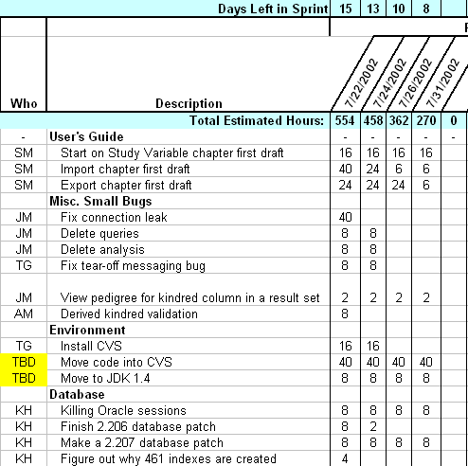
Sample Sprint Backlog
77

Slide 78
Sprints
Scrum projects make progress in a series of “sprints”
Analogous to XP iterations
Target duration is one month
+/- a week or two
But, a constant duration leads to a better rhythm
Product is designed, coded, and tested during the sprint
78

Slide 79
Sequential vs. Overlapping Dev.
Requirements
Design
Code
Test
79

Slide 80
Scrum Methodology
Customer
Customer
Customer
Customer
Customer
New Business Driver
Priorities
Priorities
Planned
Sprint
Planned
Sprint
Planned
Sprint
Planned
Sprint
Planned
Sprint
Planned
Sprint
Planned
Sprint
Planned
Sprint
Planned
Sprint
Priorities
Planned
Sprint
Planned
Sprint
Planned
Sprint
Priorities
Priorities
Priorities
Priorities
Deliverable
Product
30 Day
Sprint
30 Day
Sprint
30 Day
Sprint
30 Day
Sprint
30 Day
Sprint
30 Day
Sprint
Release
30 Day
Sprint
100% Tested
80
Notes:
Naresh.E, Lecturer, Dept. of ISE, MSRIT, Bangalore-54.
80

Slide 81
SCRUM Development Process
Roles
Artifacts
Meetings
Process
Stakeholders:
Observe & Advise
Increment
Sprint Planning
Version of the product
Shippable function – tested, documented, etc
Inputs: Product Backlog, Current Business Conditions
Host: Scrum Master – 1 day
Select highest priority items
Team updates sprint backlog
Output: Sprint Backlog
Product Backlog
Increment
Sprint:
30 Days
Product Owner:
Sets Priorities
Product Backlog (areas)‏
List of requirements and issues
Owned by Product Owner
Everyone can add to it
Only the Product Owner prioritizes
Sprint Planning Meeting
Daily Scrum
Host: Scrum Master – 15 minutes
Attendees: All, stakeholders are
don’t speak
Same time every day
Answer:
What did you do yesterday?
What will you do today?
What is in your way?
Team updates Sprint Backlog
Scrum Master updates Block List
Sprint Backlog
Daily Scrum
Blocks List
Team:
Develop Product
Product
Sprint Backlog
Sprint Goal
Daily Work
List of tasks (4-16 hours)‏
Owned by team
Only the team can modify it
Increment
Sprint Review Meeting
Scrum Master
Manages Process,
Removes roadblocks
Block List
List of obstacles
Owned by Scrum Master
Updated daily
Sprint Review
Host: Scrum Master - 1 Day
Attendees: All
Team demonstrates increment
All discuss; gather feedback
Hold retrospective (team only)‏
Product Backlog
81

Slide 82
Advantages / Disadvantages
Greater ability to adapt
Encourages initial design with ongoing rearchitecture
Early, frequent delivery of software
High visibility into projects
Undisciplined due to lack of process followed
More responsibility passed to developers to do the right thing
Needs local customization
It’s a new approach.
82

Slide 83
References
Roger.S.Pressman, Software Engineering-A Practitioners approach, Seventh Edition,McGraw-Hill, 2007.
Ian Sommerville, Software Engineering, Eight Edition, Person Education, 2007.

